Slide 1
CS 5551 Project RooKart
TEAM 16:
Sai Sriharsha Sudulaguntla (50) Lava kumar Surparaju (52) Rajesh Gupta Kollipata(24) Raghu Pavan Vallamkonda (54)

Slide 2
Introduction:
RooKart is an Android application primarily developed for UMKC community, where users can Buy/ Sell Products and Services from registered UMKC community.
For UMKC community only.
User can select the radius range from a location, where he wants to Select his service/ Product.
Reliabiltiy, Easy to approach, Easy Shipping, Easy on Pocket.

Slide 3
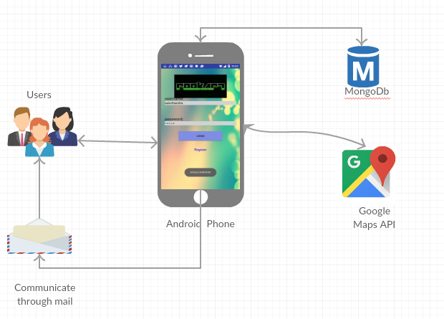
System Architecture:

Slide 4

Technologies:
Platform: Android Studio
Language: Java
IDE: Android Studio
Database: MongoDB
UML: Microsoft Vision.

Slide 5
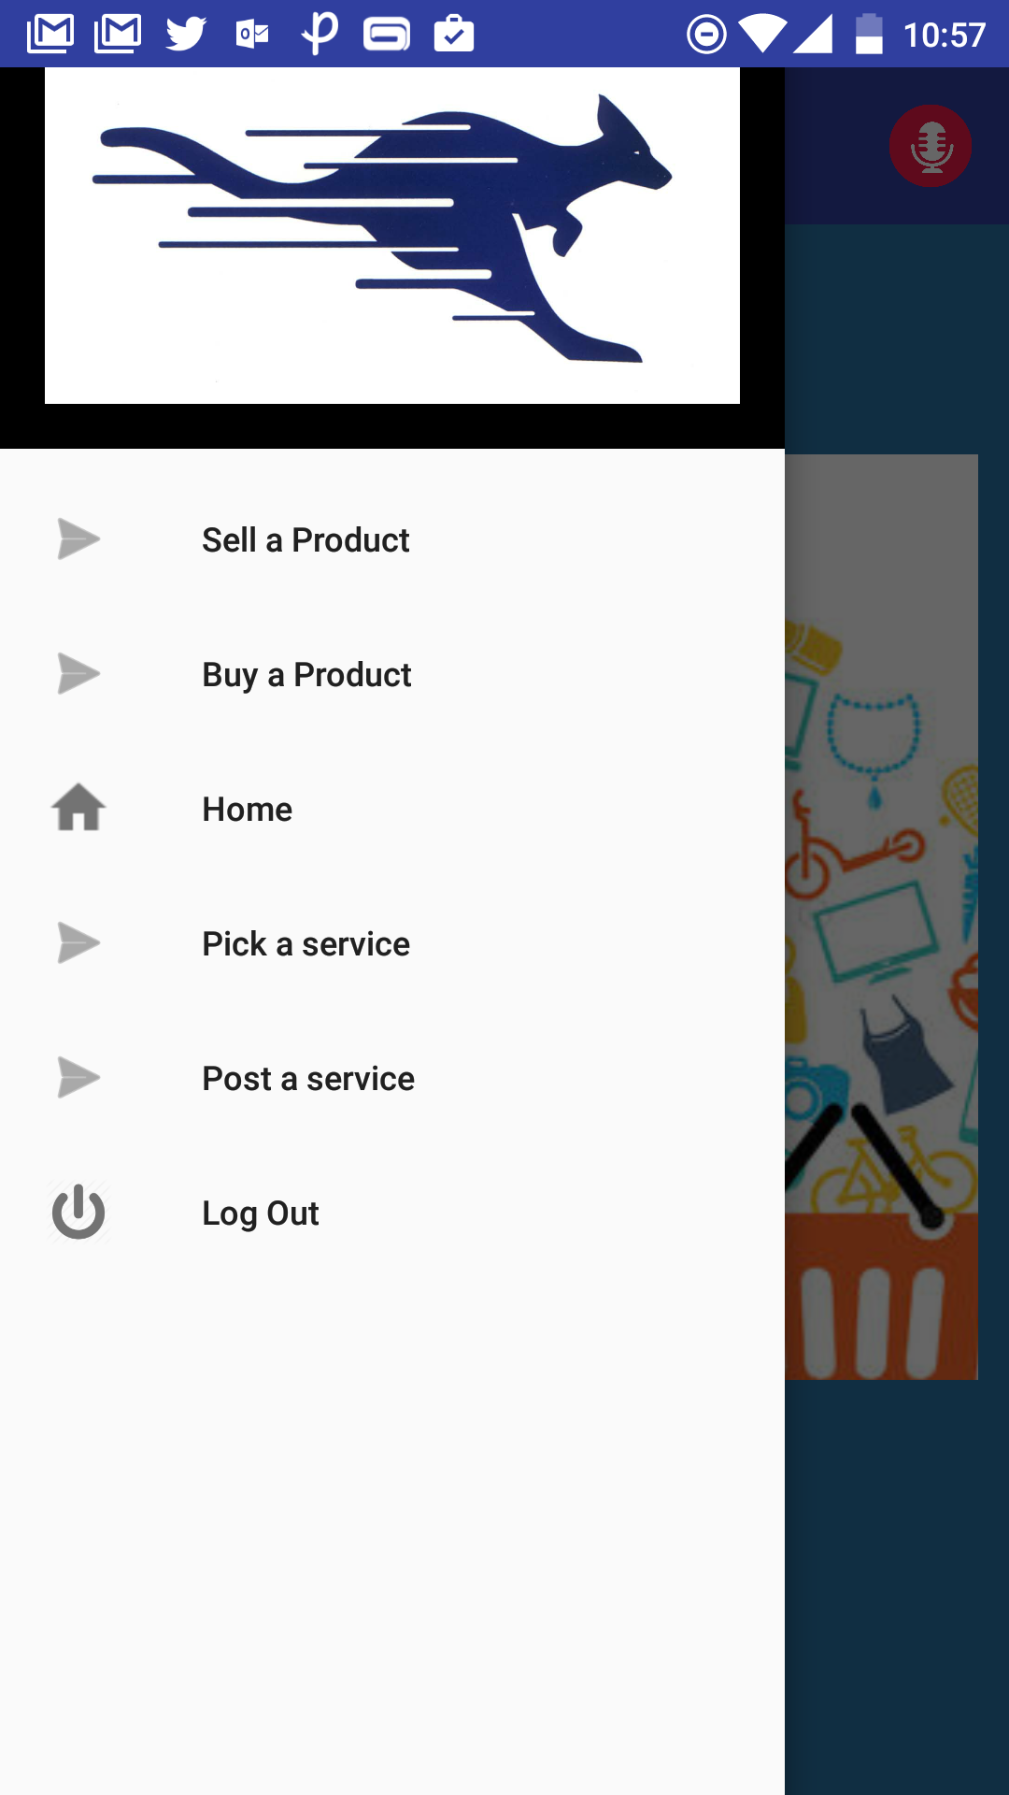
Core Functionalities:
Sell a Product.
Buy a Product.
Pick a Service.
Post a Service.

Slide 6
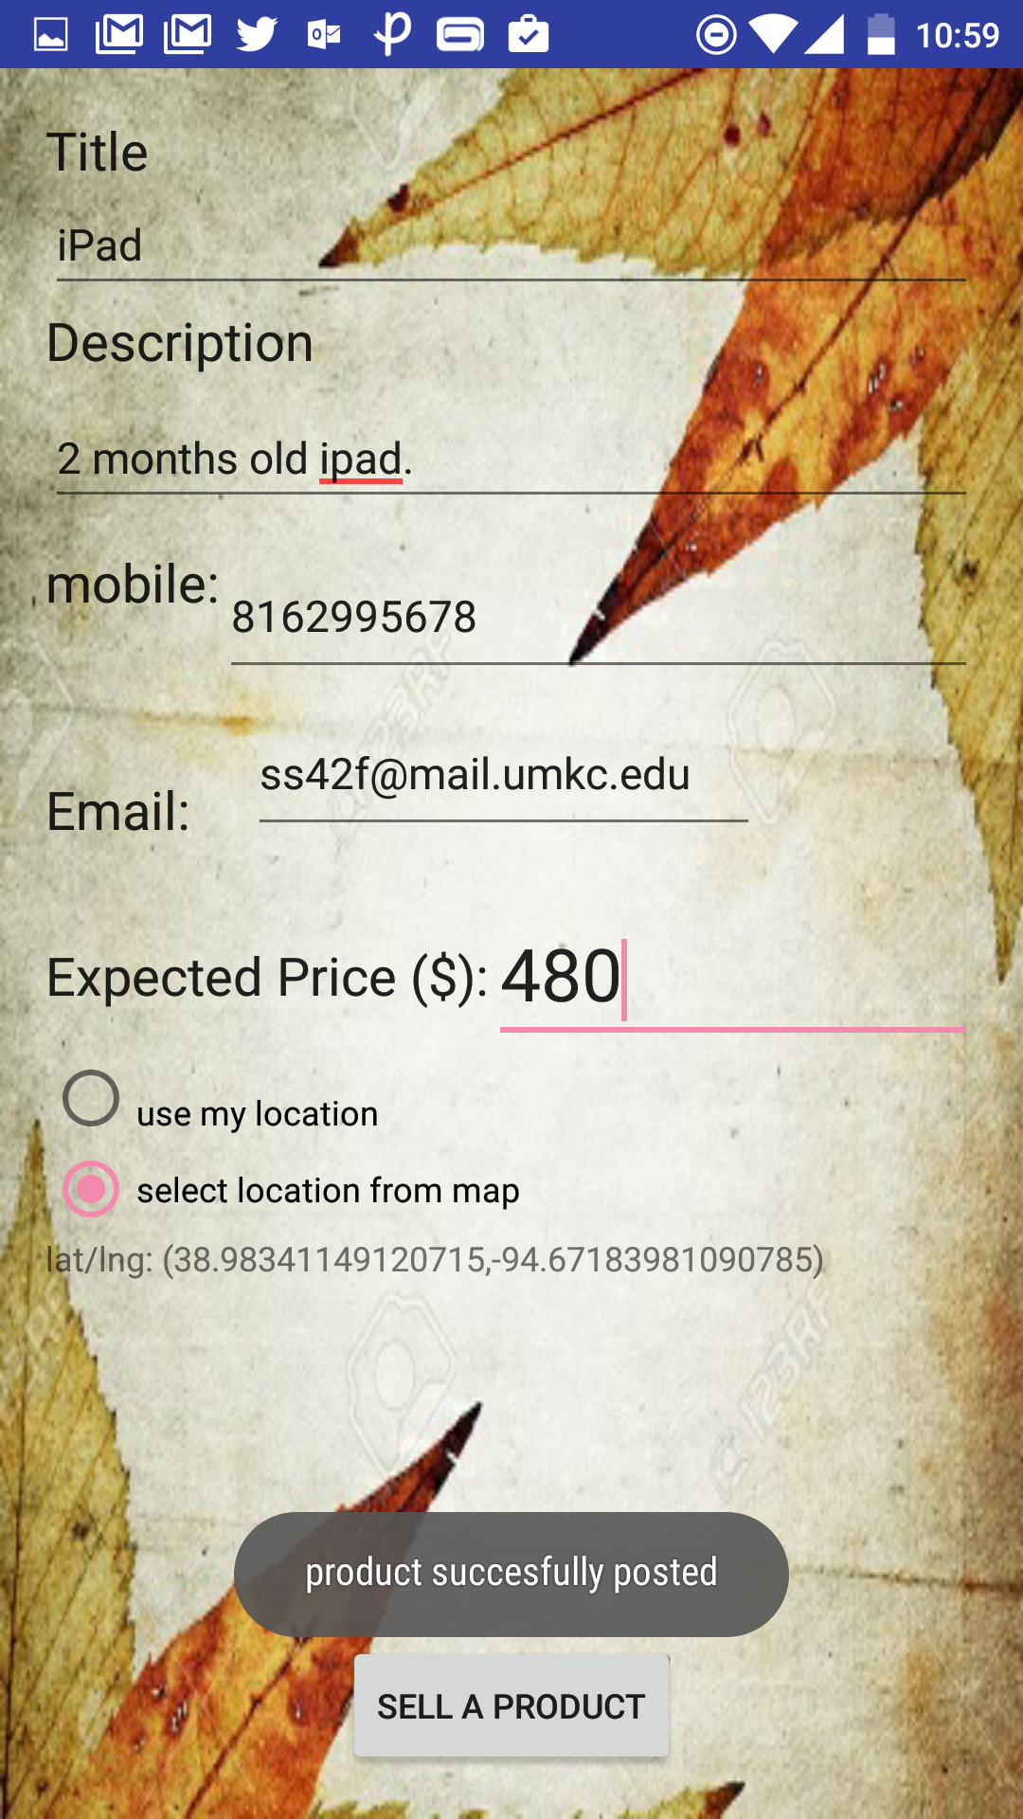
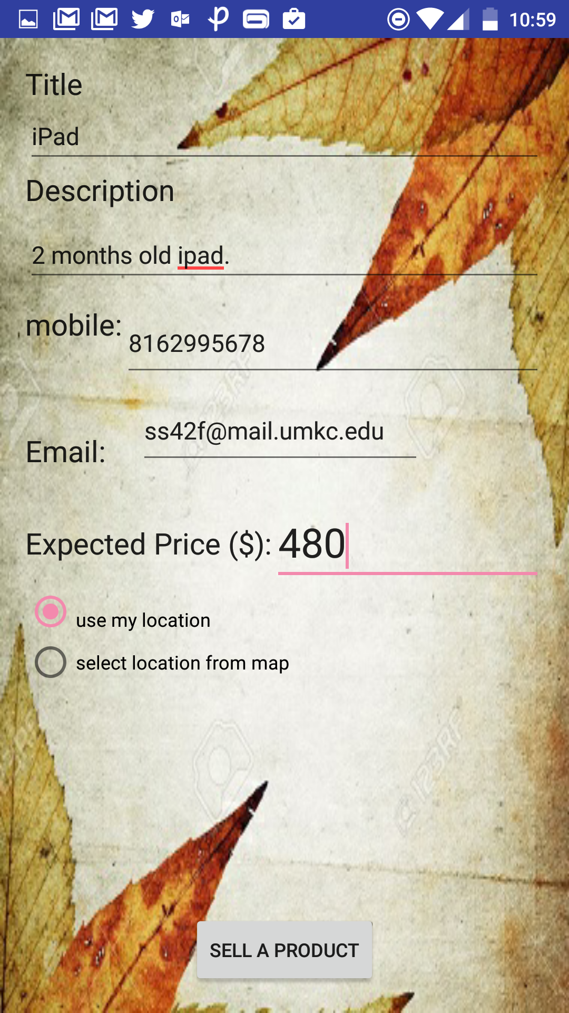
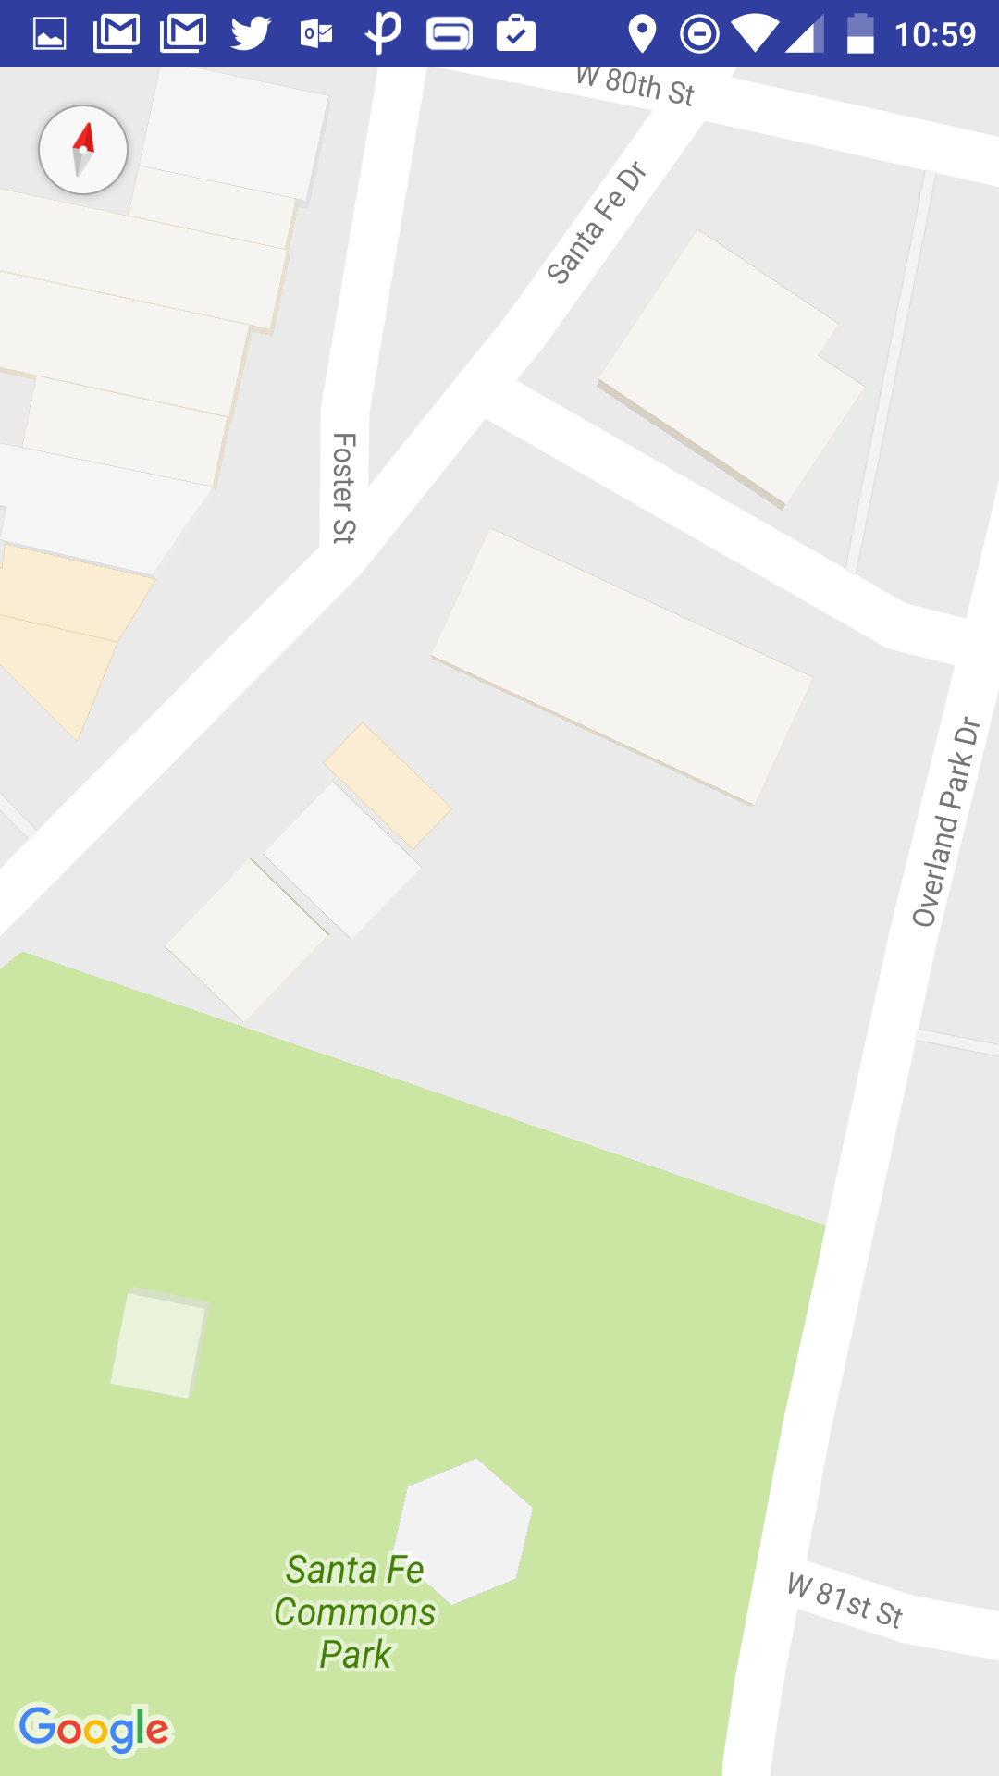
Sell a Product:

Slide 7
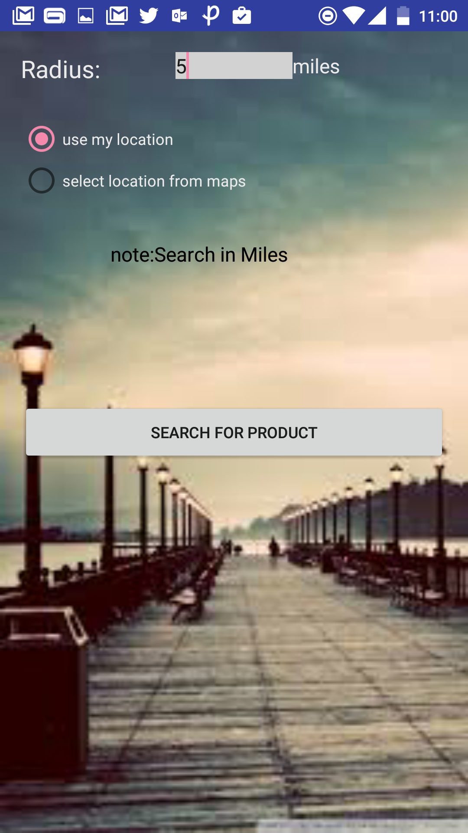
Buy a Product:
User can select a location and it surrounding radius, from
Which the search results are to be appeared.
This ensures, Easy approach, Easy Shipping, Ease of use.

Slide 8
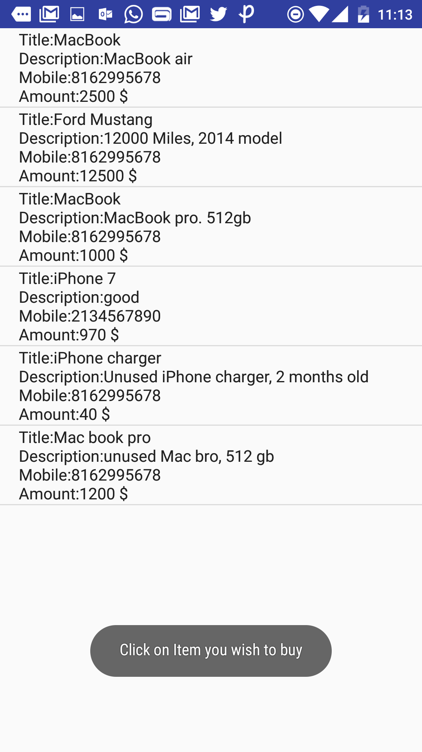
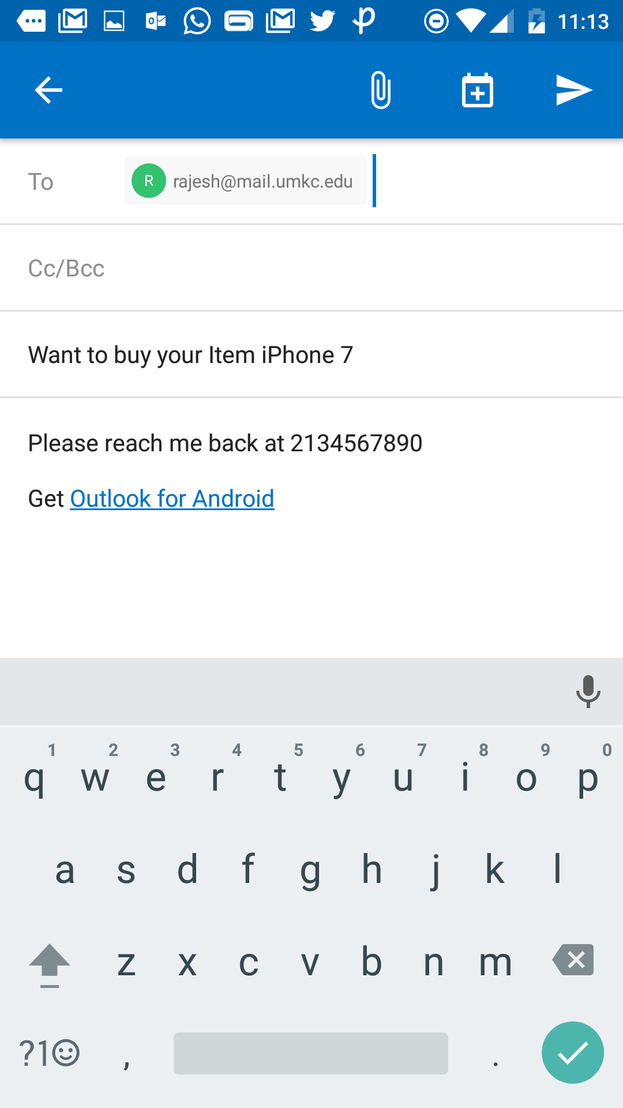

Slide 9
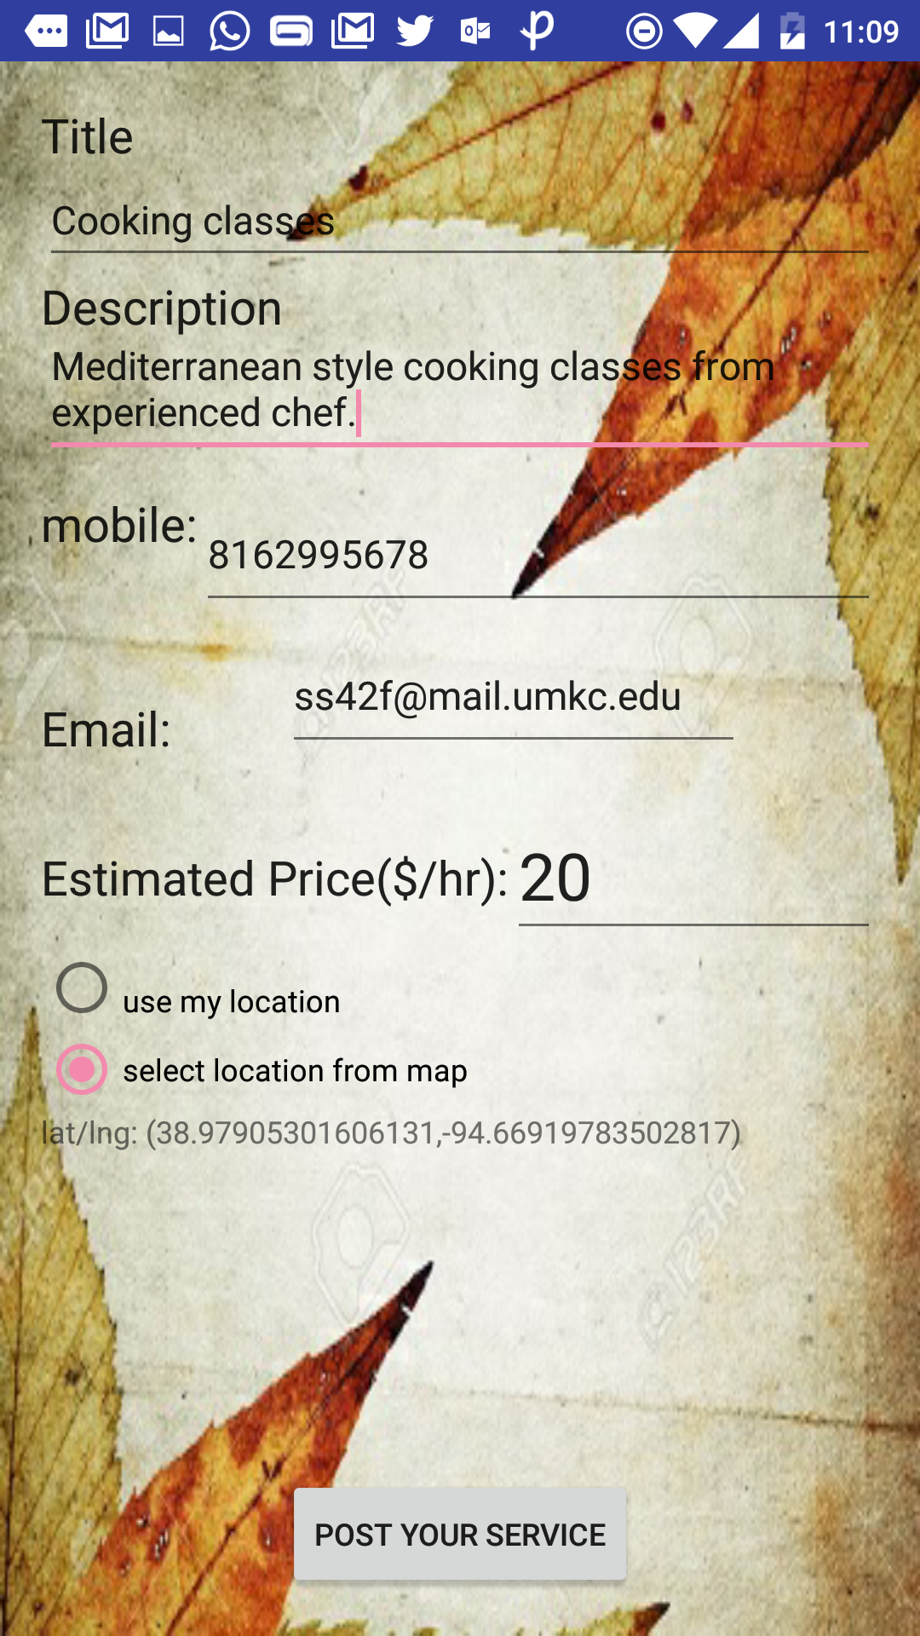
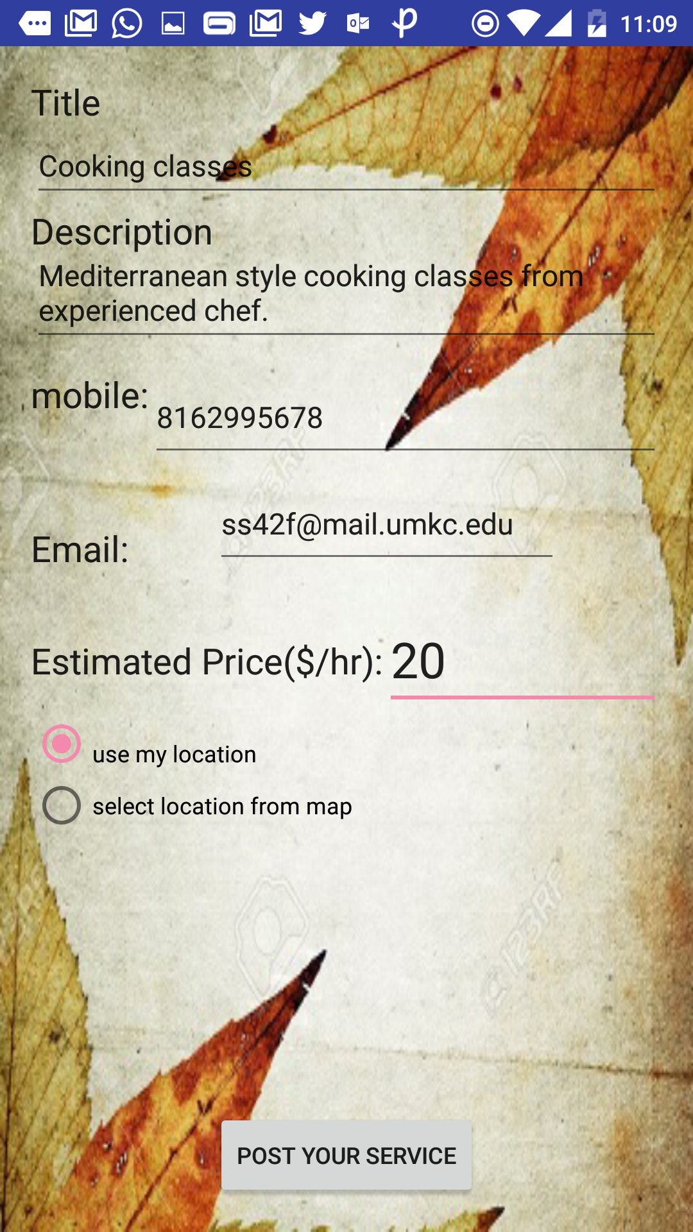
Post a Service:
User can Post a Classified
Regarding the service he
Wishes to offers.
Location: Both Current,
Select location from Map
are enabled.

Slide 10
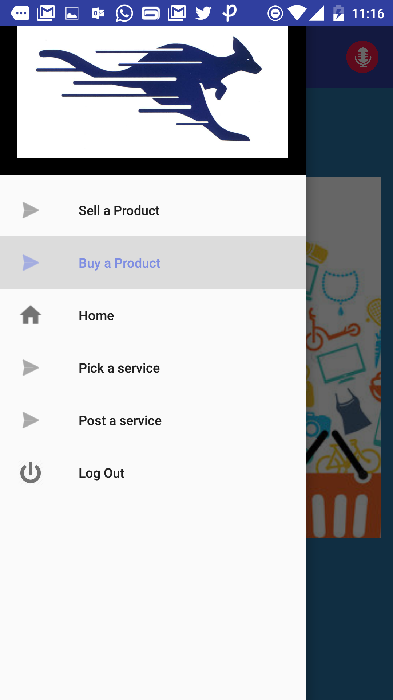
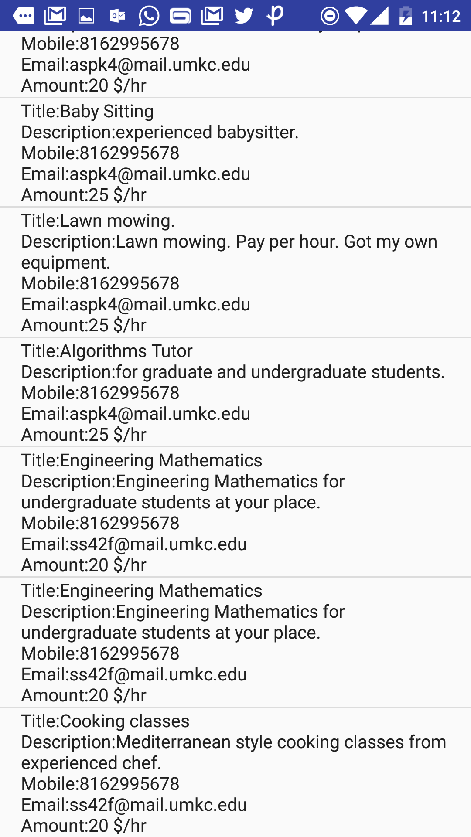
Pick a Service
The list of available services
Filtered by location are
Displayed.

Slide 11
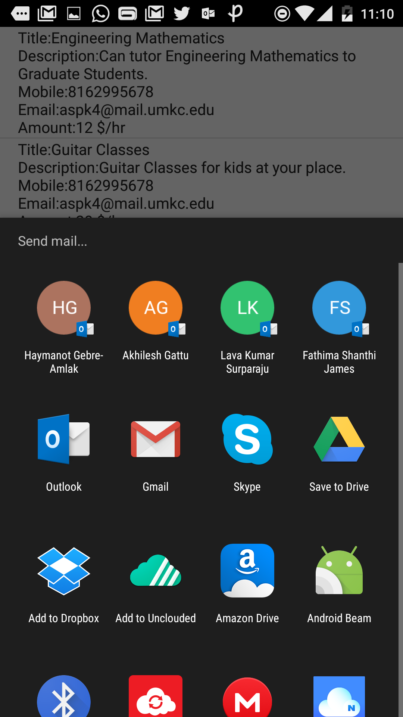
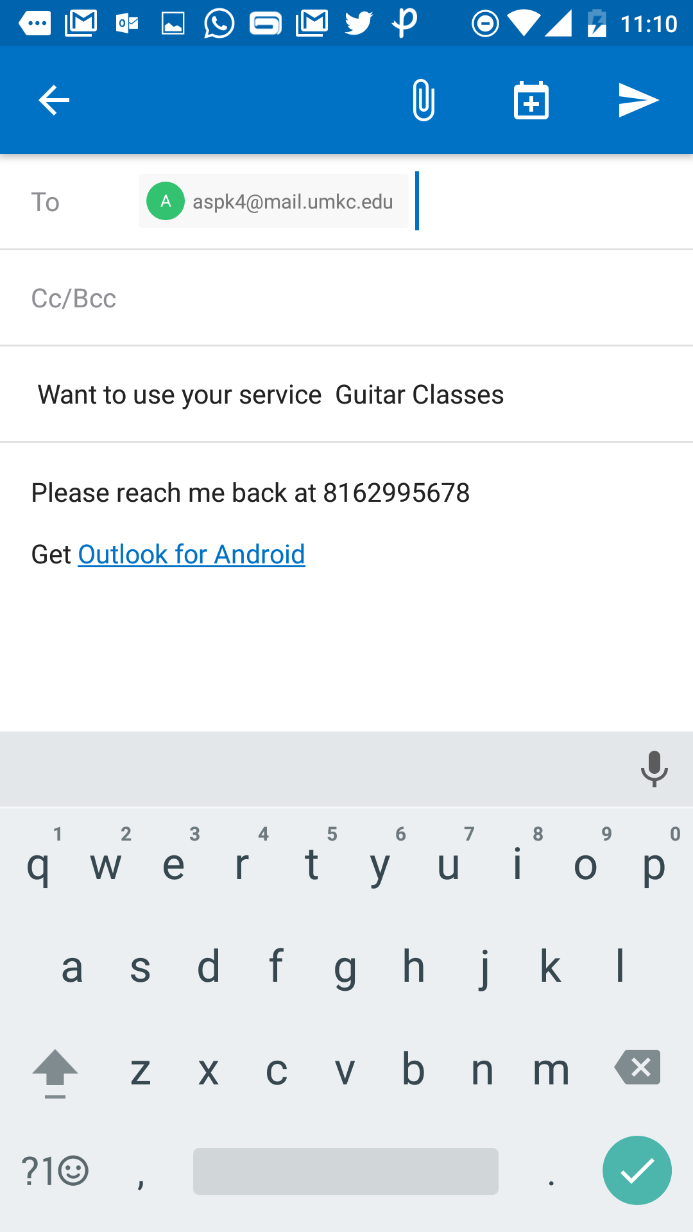
Pick a Service:
Buyer can contact the seller
With his UMKC email, or
Personal email.
A default Subject,
Buyers contact details are
Auto Prompted on the
Email.

Slide 12
Thank you!!

